Slide 1
Practice Exam 1

Slide 2
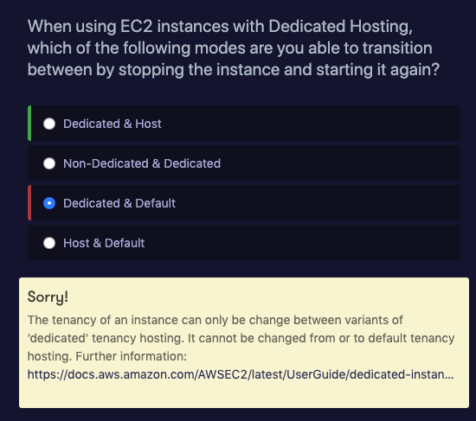
https://docs.aws.amazon.com/AWSEC2/latest/UserGuide/dedicated-instance.html

Slide 3
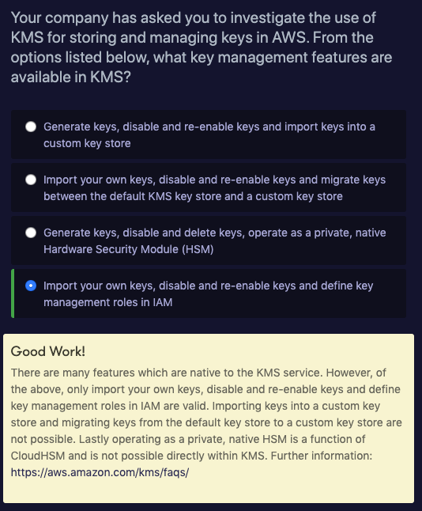

Slide 4
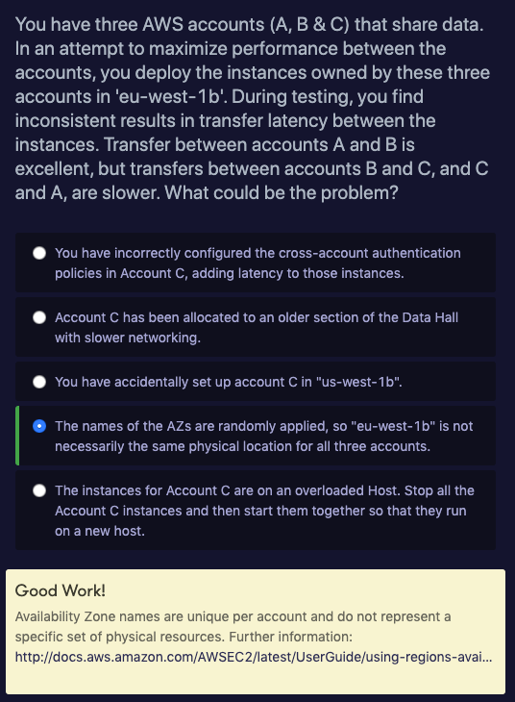
https://docs.aws.amazon.com/AWSEC2/latest/UserGuide/using-regions-availability-zones.html

Slide 5
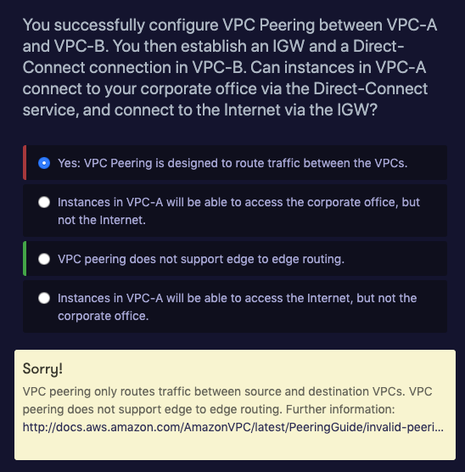
http://docs.aws.amazon.com/AmazonVPC/latest/PeeringGuide/invalid-peering-configurations.html

Slide 6
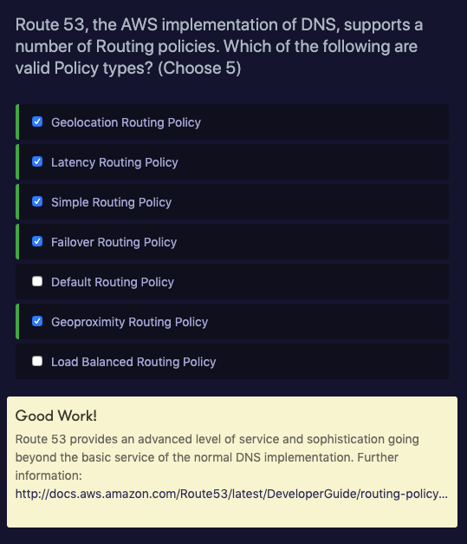

Slide 7
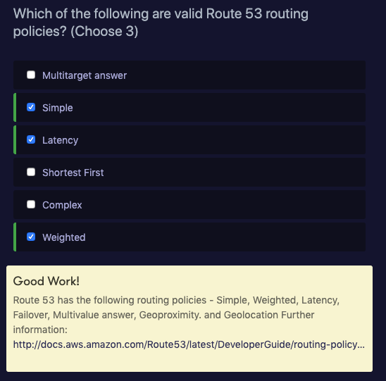

Slide 8
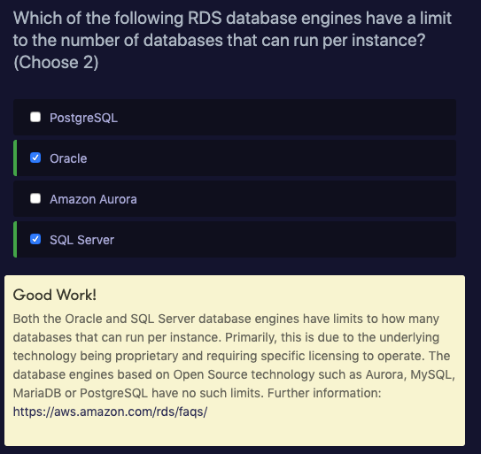

Slide 9
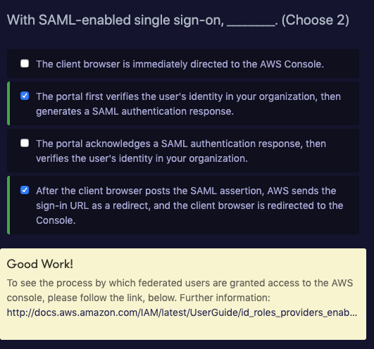
http://docs.aws.amazon.com/IAM/latest/UserGuide/id_roles_providers_enable-console-saml.html

Slide 10
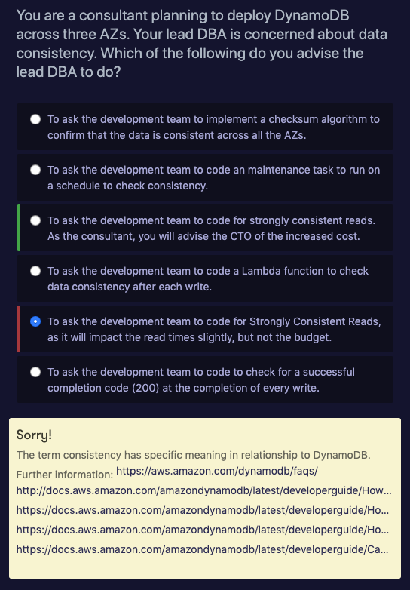

Slide 11
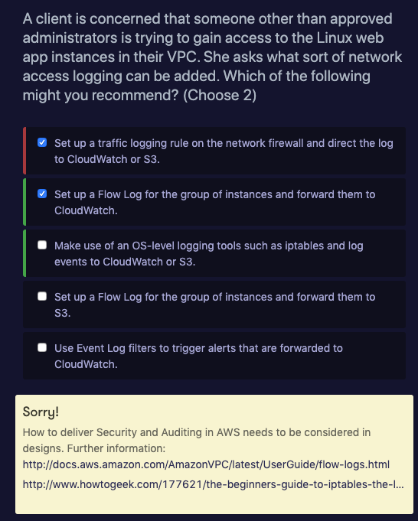
http://docs.aws.amazon.com/AmazonVPC/latest/UserGuide/flow-logs.html
http://www.howtogeek.com/177621/the-beginners-guide-to-iptables-the-linux-firewall/

Slide 12
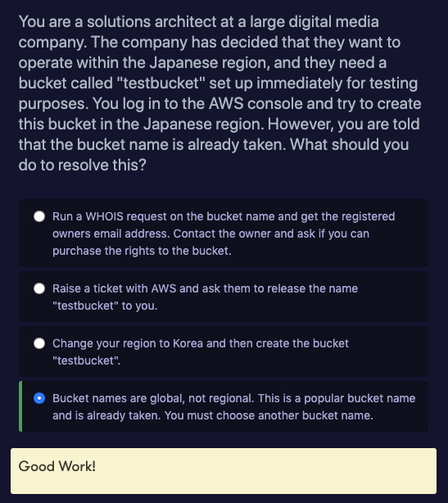

Slide 13
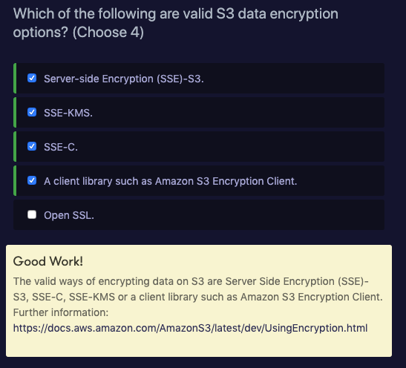

Slide 14
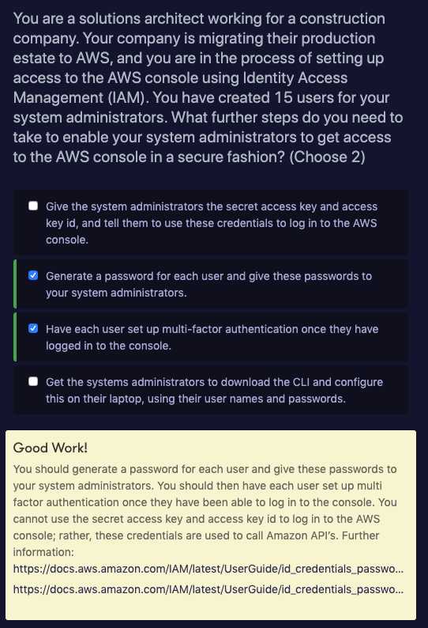

Slide 16
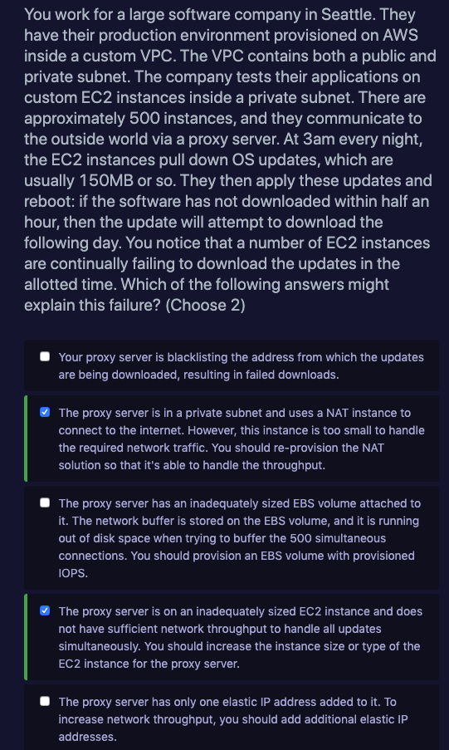
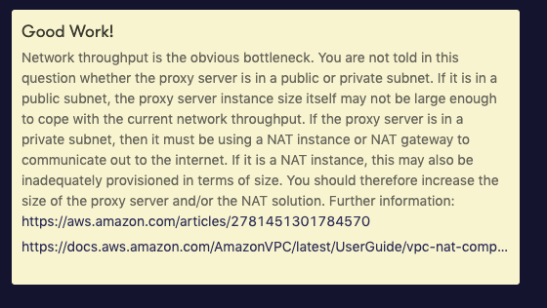

Slide 17
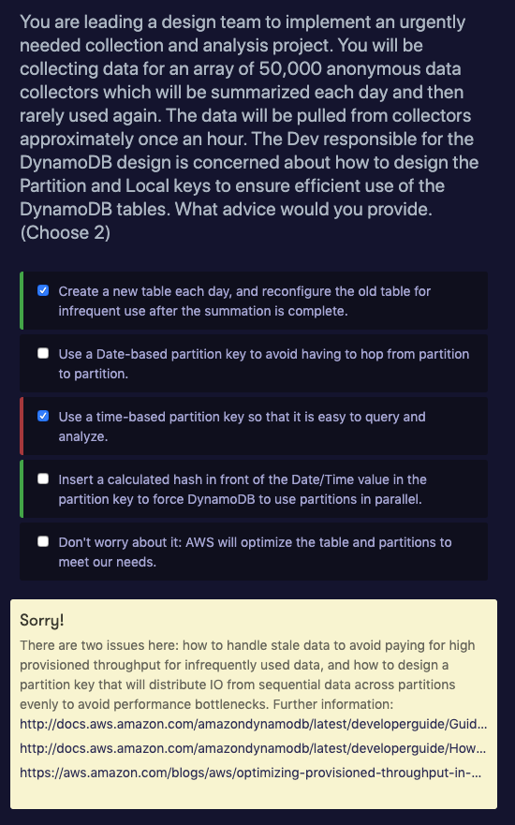
http://docs.aws.amazon.com/amazondynamodb/latest/developerguide/GuidelinesForTables.html#GuidelinesForTables.Partitions
http://docs.aws.amazon.com/amazondynamodb/latest/developerguide/HowItWorks.Partitions.html
https://aws.amazon.com/blogs/aws/optimizing-provisioned-throughput-in-amazon-dynamodb/

Slide 18
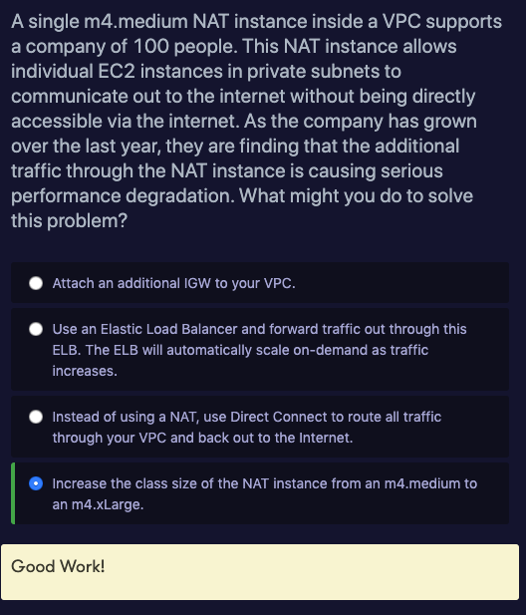

Slide 19
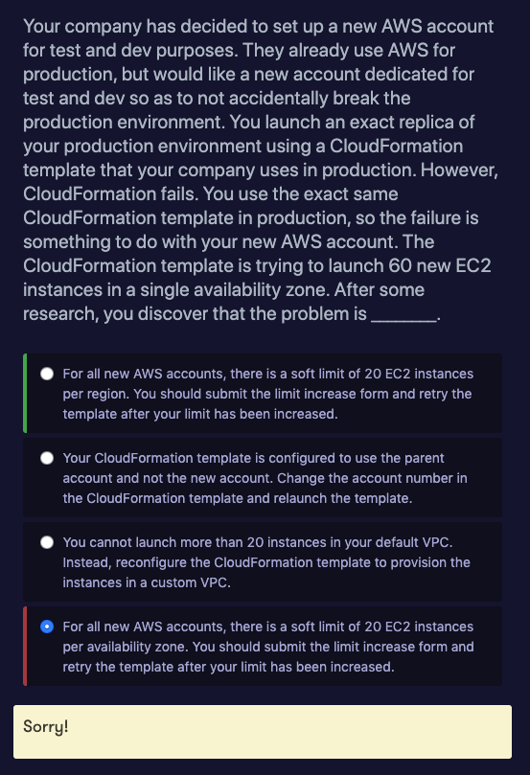

Slide 20
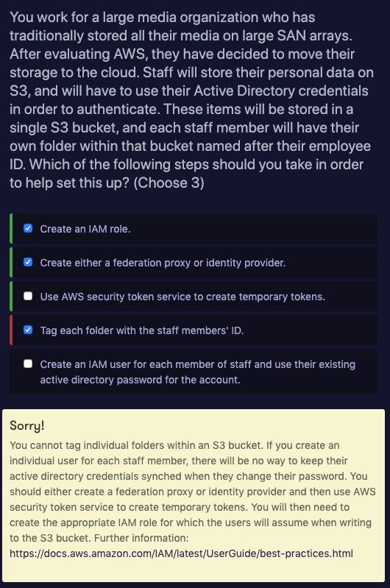

Slide 21
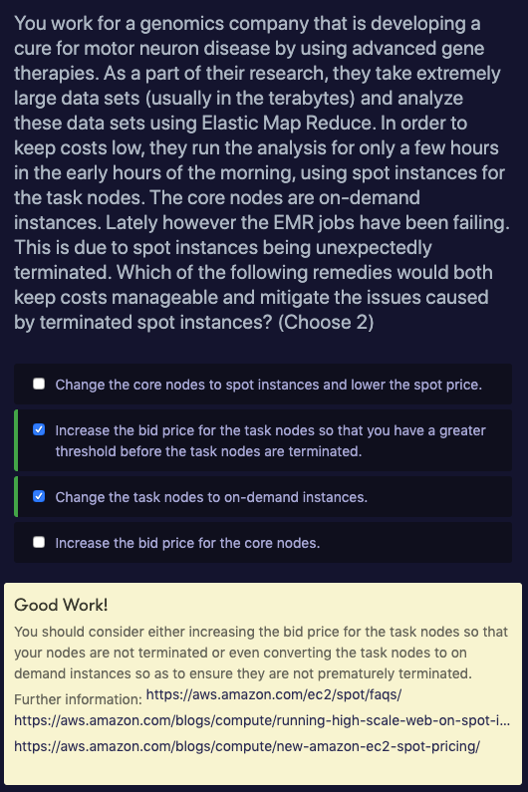

Slide 22
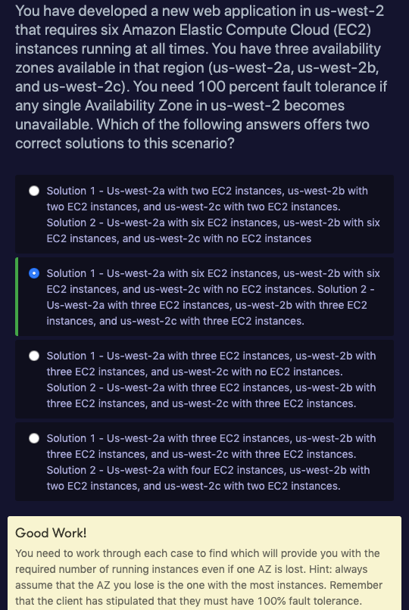

Slide 23
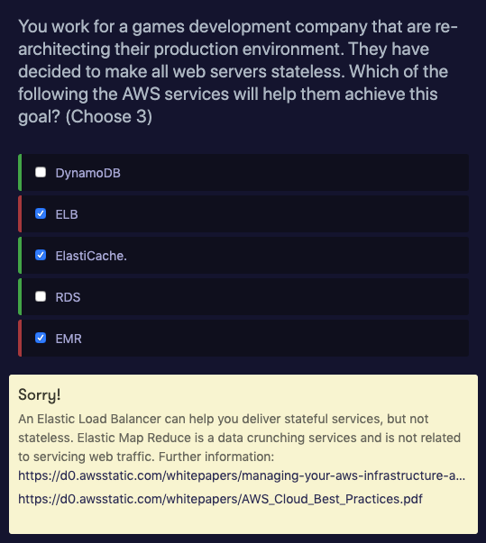
https://d0.awsstatic.com/whitepapers/AWS_Cloud_Best_Practices.pdf
https://d0.awsstatic.com/whitepapers/managing-your-aws-infrastructure-at-scale.pdf

Slide 24
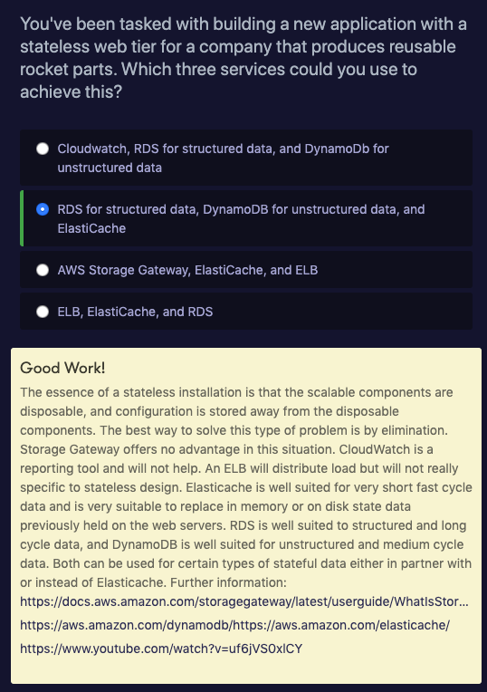

Slide 25
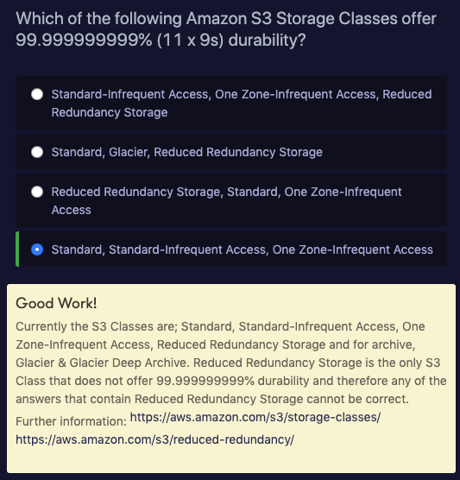

Slide 26
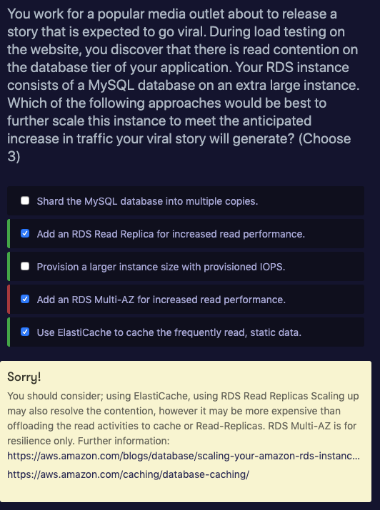

Slide 27
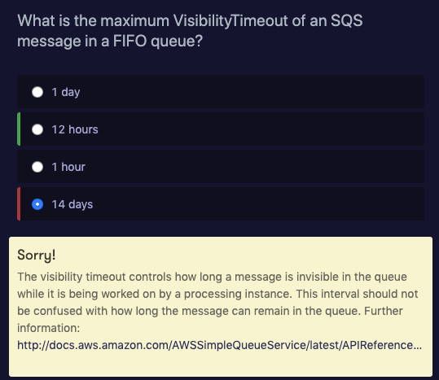

Slide 28
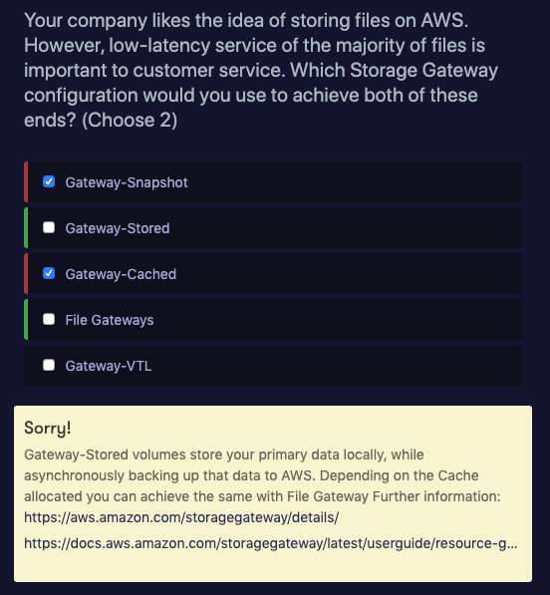
https://aws.amazon.com/storagegateway/details/

Slide 29
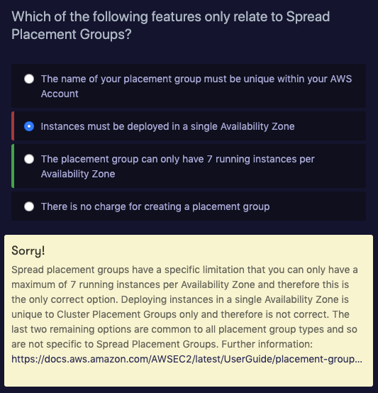

Slide 30
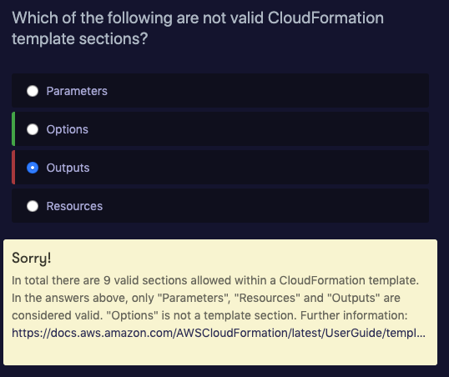

Slide 31
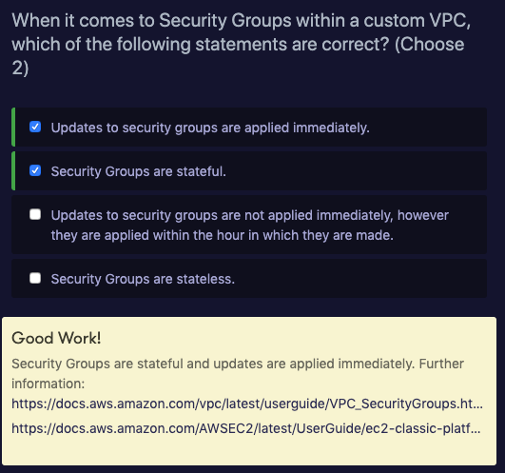

Slide 32
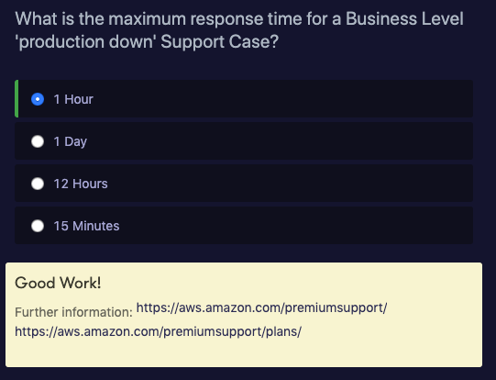

Slide 33
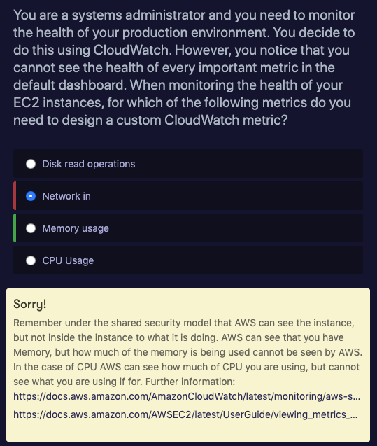

Slide 34
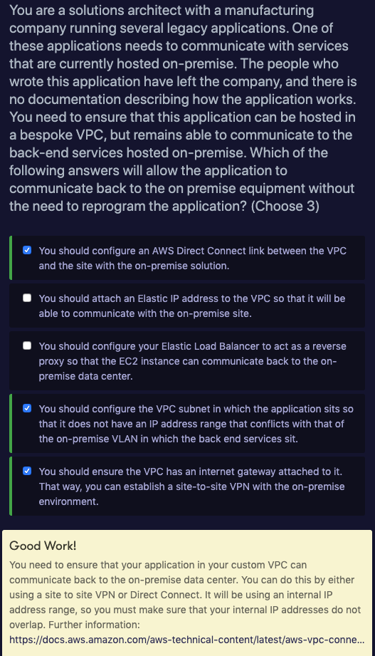

Slide 35
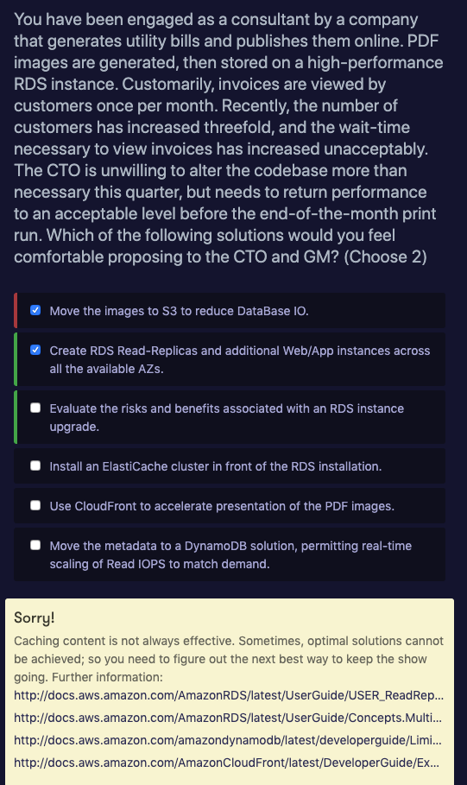

Slide 36
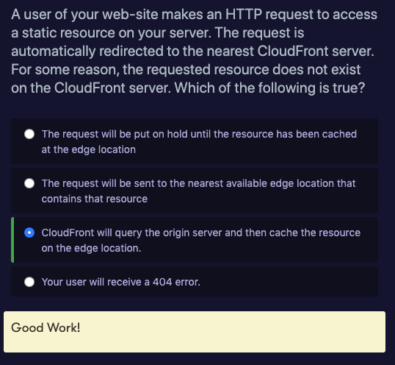

Slide 37
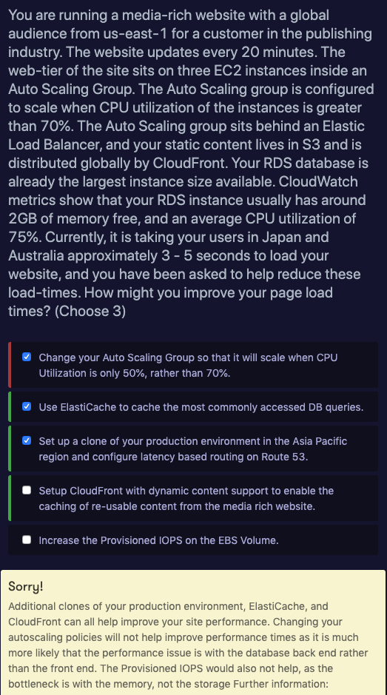

Slide 38
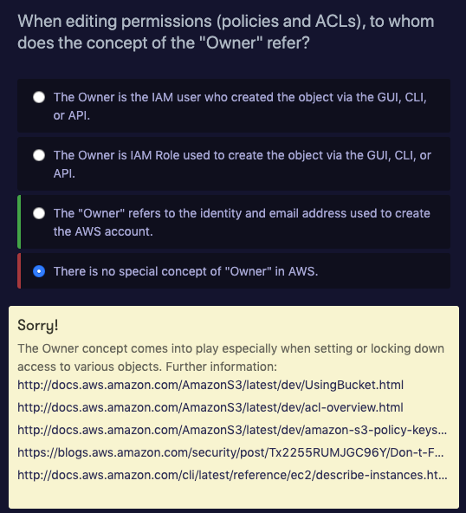

Slide 39
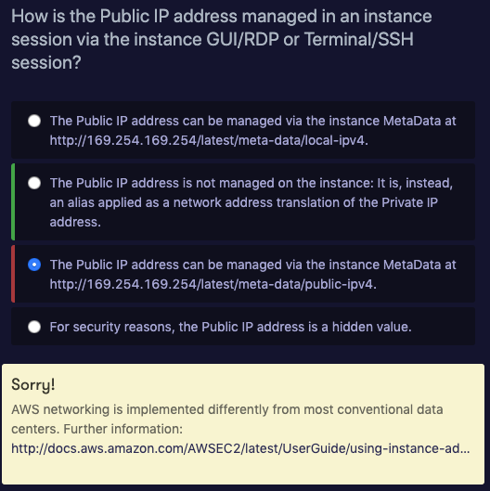
http://docs.aws.amazon.com/AWSEC2/latest/UserGuide/using-instance-addressing.html

Slide 40
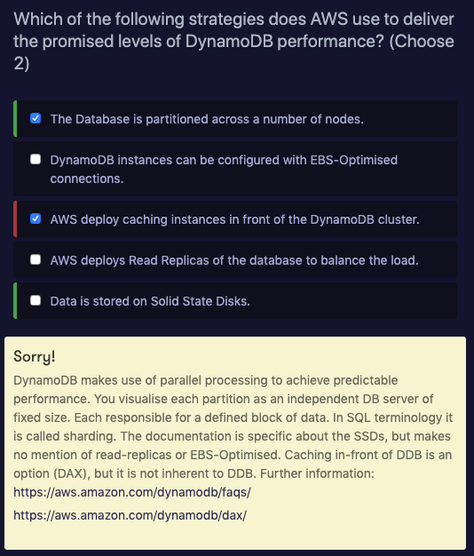

Slide 41
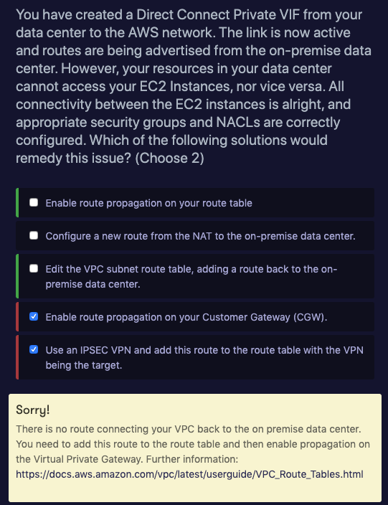

Slide 42
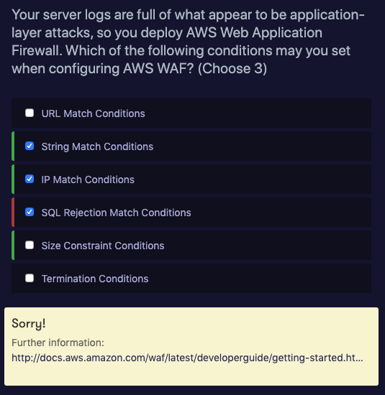
http://docs.aws.amazon.com/waf/latest/developerguide/getting-started.html#getting-started-wizard-create-web-acl

Slide 43
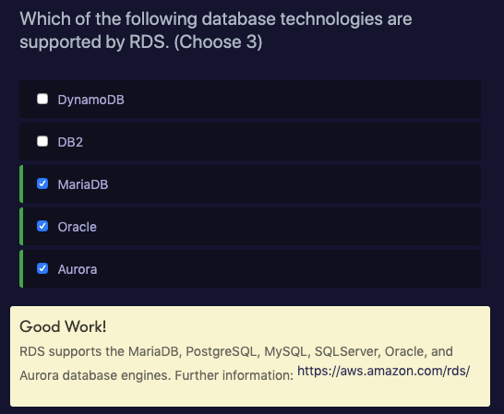

Slide 44
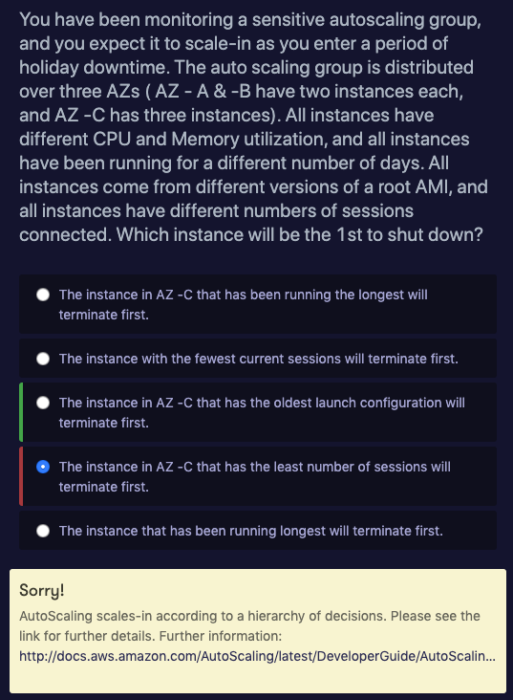
http://docs.aws.amazon.com/AutoScaling/latest/DeveloperGuide/AutoScalingBehavior.InstanceTermination.html

Slide 45
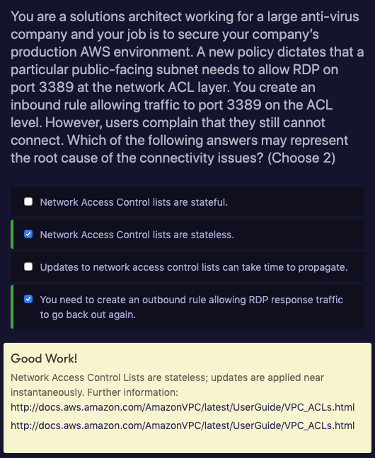

Slide 46
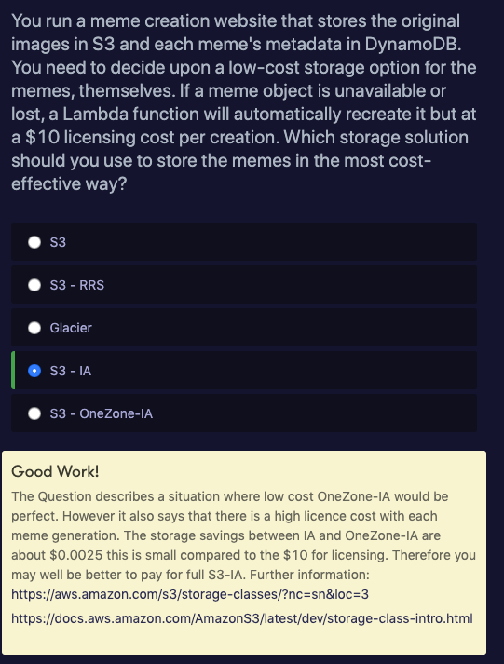

Slide 47
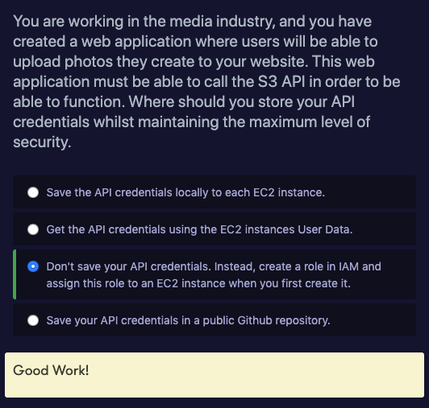

Slide 48
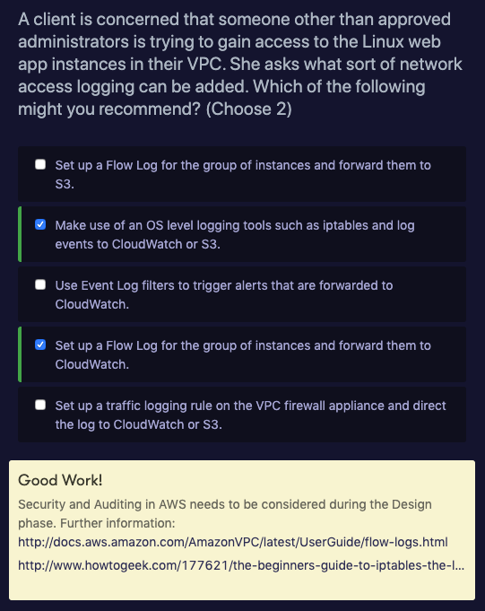

Slide 49
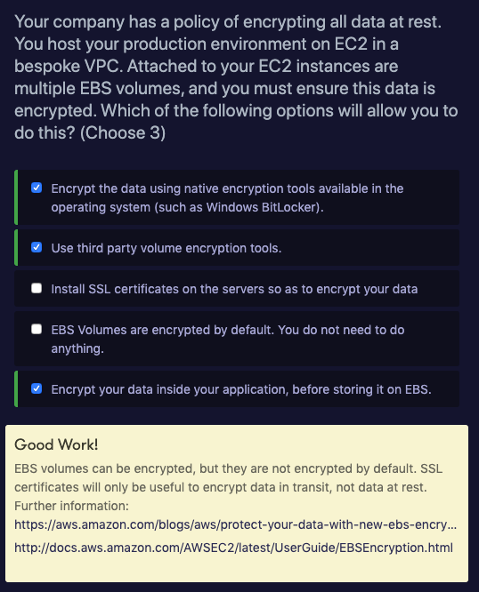

Slide 50
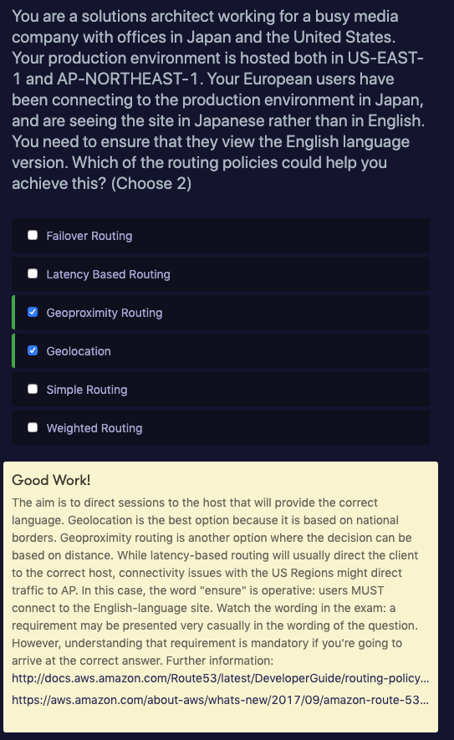

Slide 51
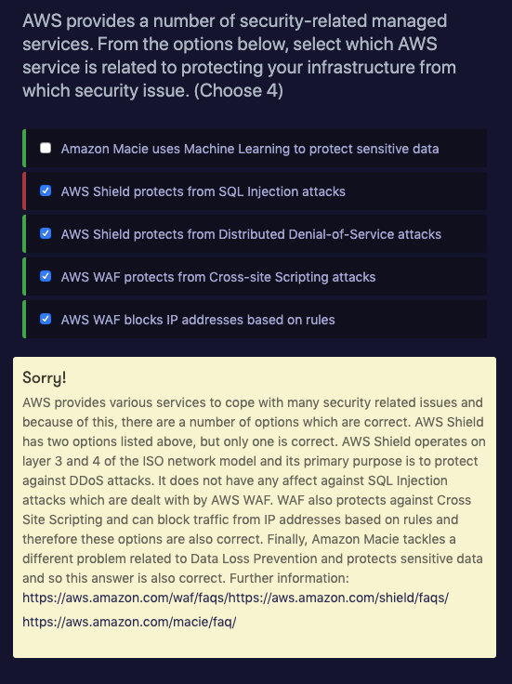

Slide 52


Slide 53


Slide 54


Slide 55


